Slide 1
BikeStore Sales Problems Statement
Sales growth yearly basis
Sales by states and growth
Sales trends by months (best selling months)
Revenue by states and their growth
Sales by each stores
Revenue by brand and sales reps
Revenue by category and Top N customers

Slide 2
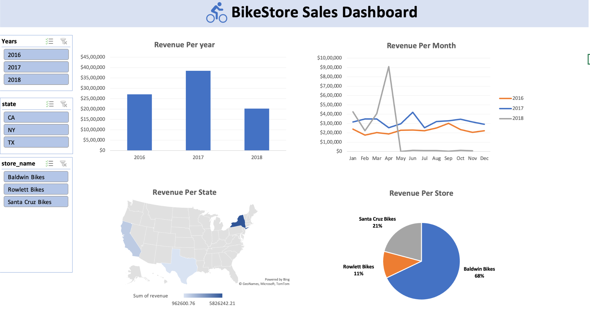

Slide 3
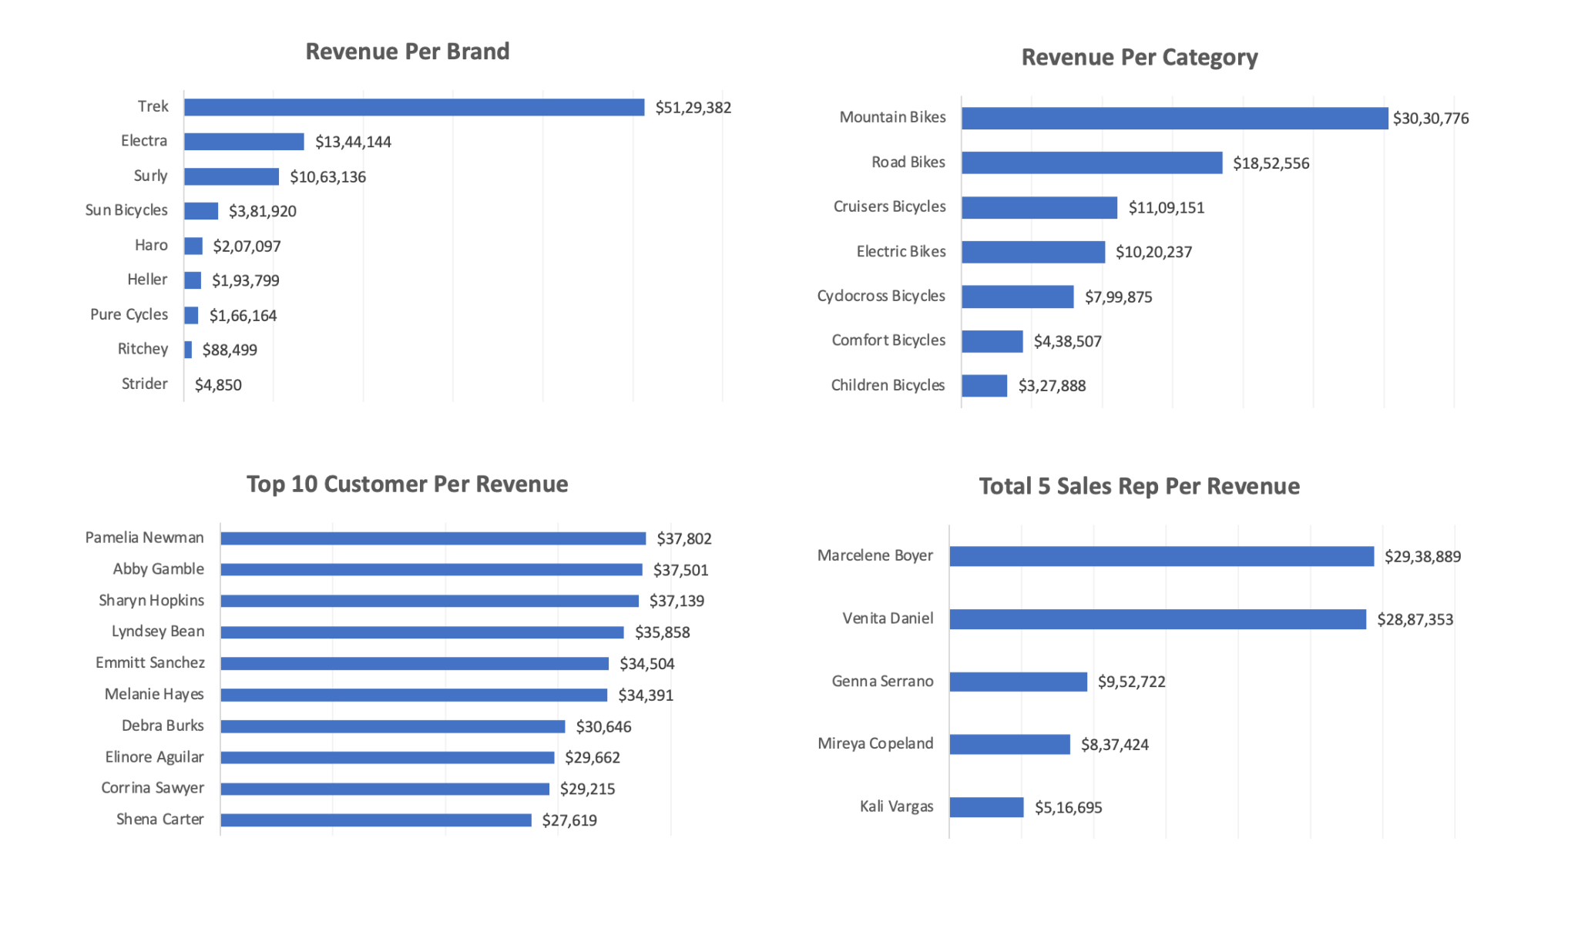

Slide 4
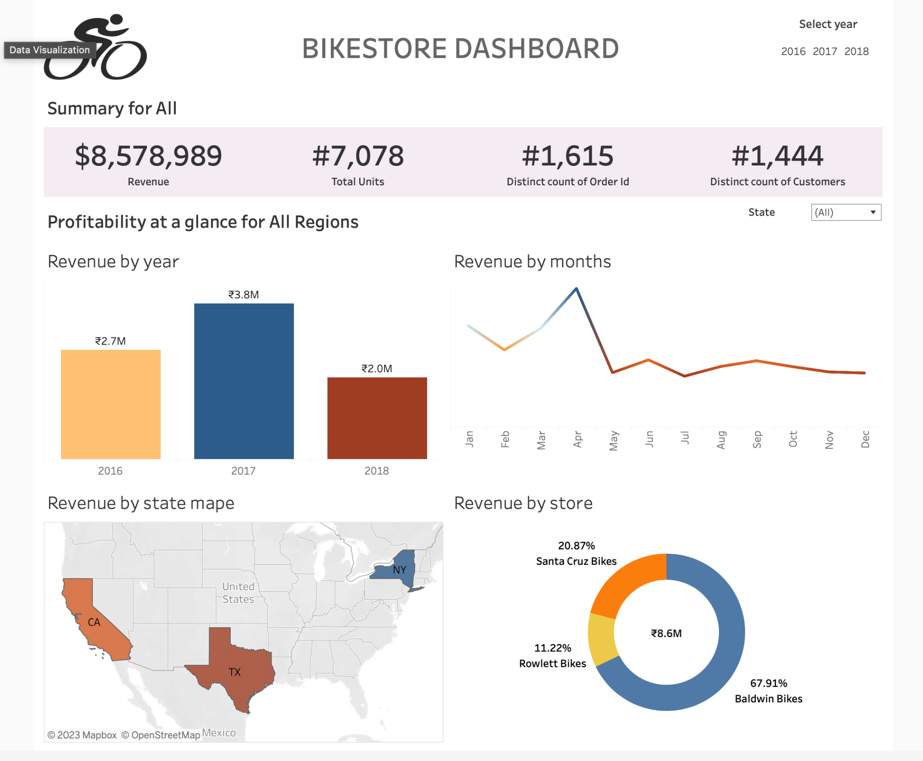

Slide 5
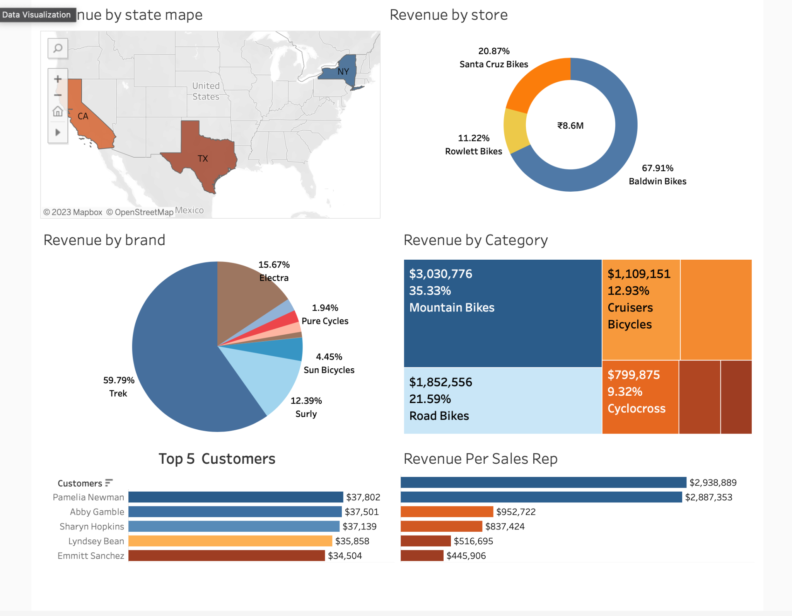

Slide 6
In conclusion, our analysis of BikeStore sales has equipped us with actionable insights for strategic decision-making. Excel provided a robust foundation for data analysis, while Tableau's visualizations enhanced our understanding. Key findings include top products, customer segmentation, and regional trends. Moving forward, these insights will inform targeted marketing and inventory strategies, ensuring our competitiveness in the market. Thank you for your attention, and I welcome any further discussion or questions.

